Slide 1
GEOHACKATHON CLOSE OUT PRESENTATION
GeoRocks
Alexey Borisenko
Amalachukwu Immaculata Muoghalu
Ayush Tyagi
Johana Ramirez-Bernal
Maria Fernanda Leon Carrera
Yohanes Nuwara
15th December 2021

Slide 2
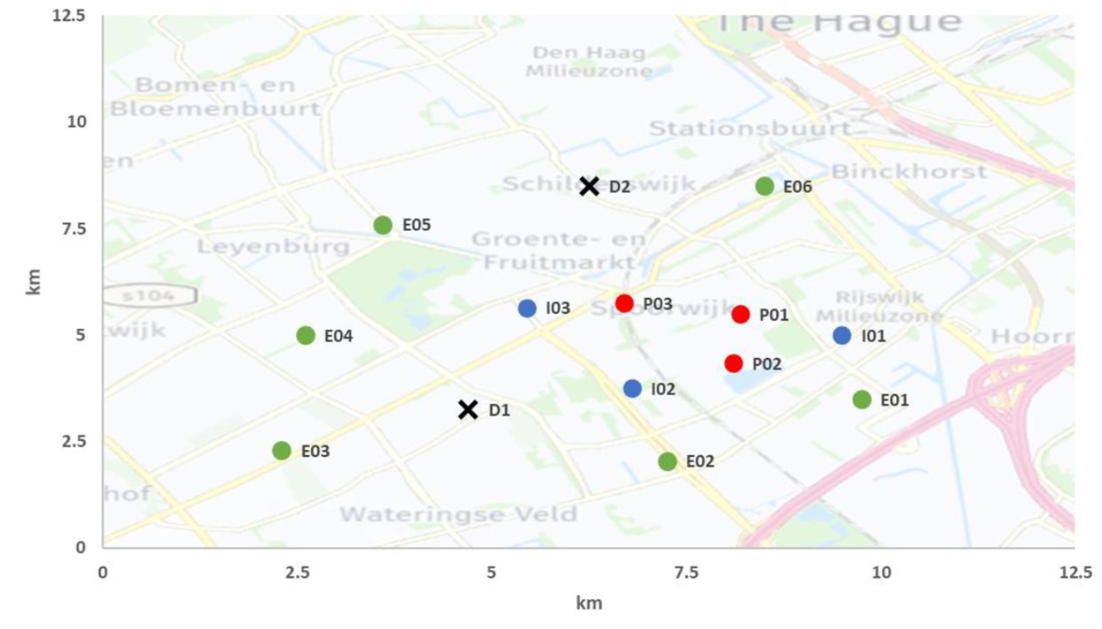
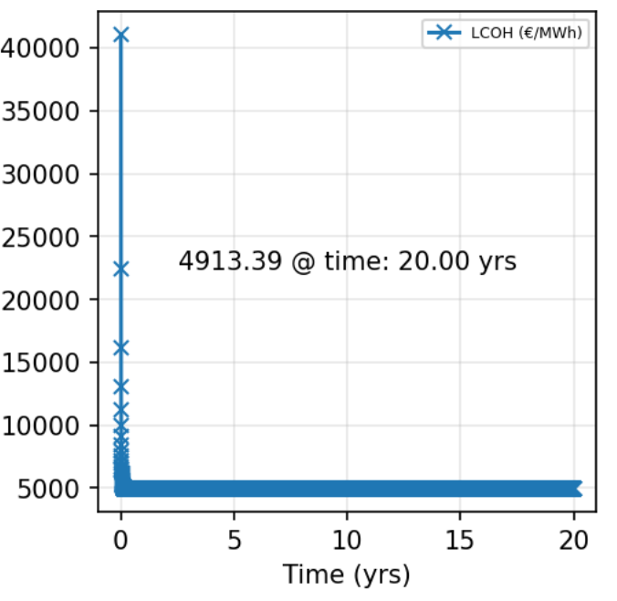
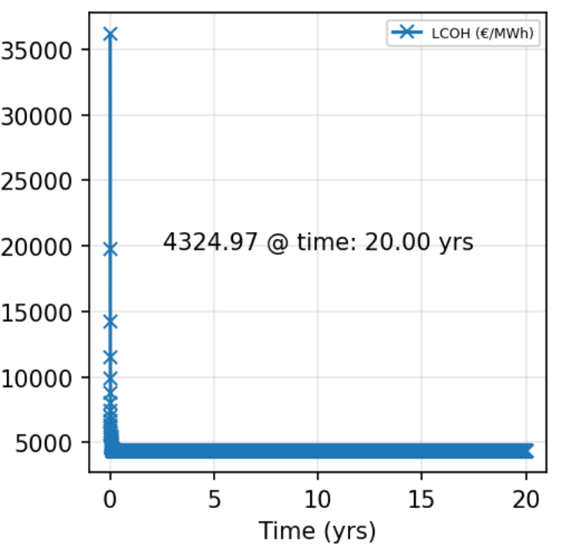
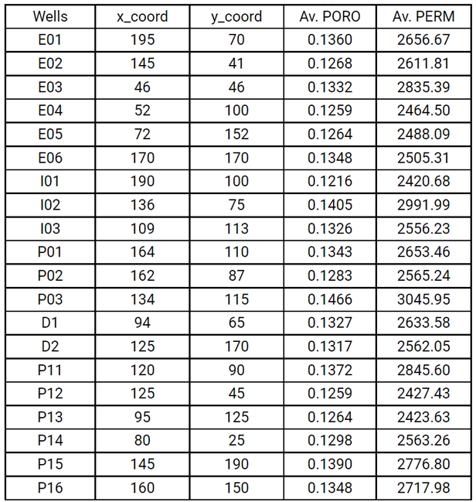
1. Recommendations
Recommendations:
Outline development plan includes all 12 available wells
6 additional production wells (P11-P16) are proposed
D1 demand point connected to 4 producers and 4 injectors
D2 demand point connected to 5 producers and 5 injectors
LCOH (20 years): D1 - 4913€/MWh, D2 - 4325€/MWh
P15
P16
P13
P11
P14
P12
D1
D2

Slide 3
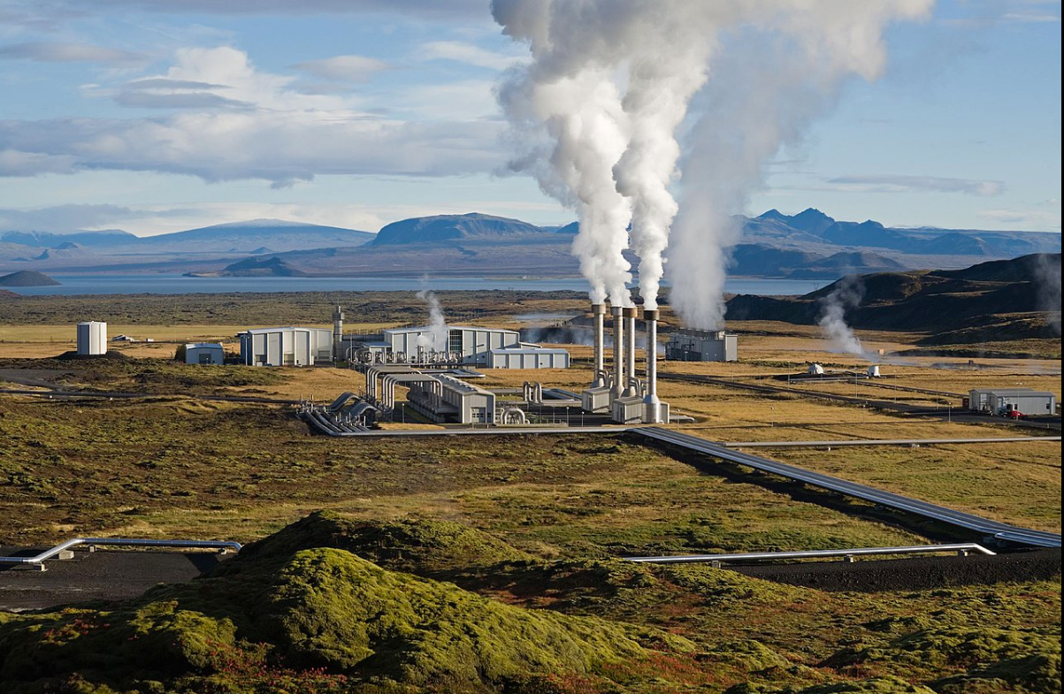
2. Short background of the project
A block of 12.5 x 12.5 km contains several producer, injectors and exploration wells
There are two demand locations:
- D1 - 80 MWth
- D2 - 100 MWth
Prime Focus of the team:
- To satisfy the demand for 20 years
- To minimize the cost
Set Location of New Wells
Calculate Produced Energy
Calculate Cost
Satisfactory
Not Satisfactory
Calculate LCOH

Slide 4
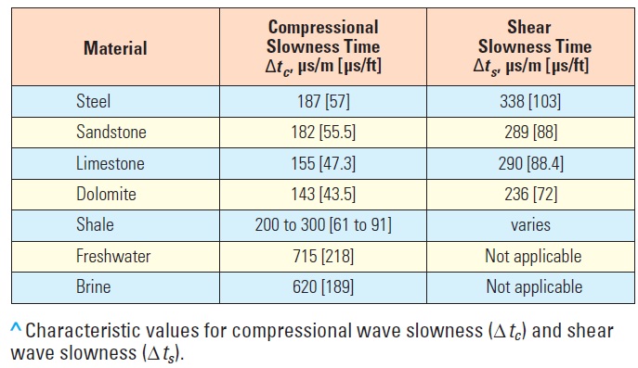
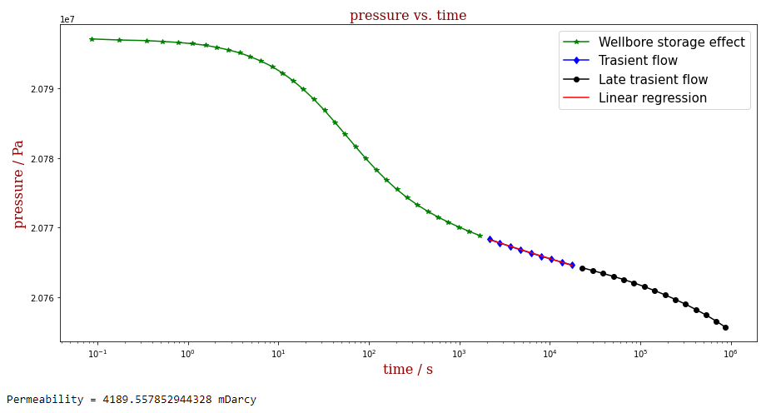

3. Information that was used
Selection criteria:
Couple of injectors and producers close to places of demand.
Additional exploratory wells on the periphery of demand locations.
Based on selection criteria and established budget: €120,000, six (6) out of 12 wells were identified to acquire data (Log’s cost: €10,000/well, Well test’s cost: €15,000/well)
Well data: 6 sonic logs and 4 well test. From Sonic logs, it was estimated porosity by using Wyllie et al. 1958 equation. From well tests, it was estimated permeability by using transient solution.
Well | Log | Test
I03 | 1 | 1
P03 | 1 | 1
I02 | 1 | 1
E05 | 1 | 0
P02 | 1 | 0
E06 | 1 | 1
 | €120,000
I02 well
Notes:
Wyllie, M.R.J., Gregory, A.R. and Gardner, G.H.F., 1958, An experimental investigation of the factors affecting elastic wave velocities in porous media, Geophysics, v. 23, p. 459-493.
Alfor, J., Blyth, M, Tpllefsen, E., Crowe, J., Loreto, J., Mohammed, S., Pistre, V., Rodriguex-Herrera, A., Sonic loggin while drilling - Shear Answer, Oilfield Review Sptring 2012, v.24 n.1, p.4-15

Slide 5
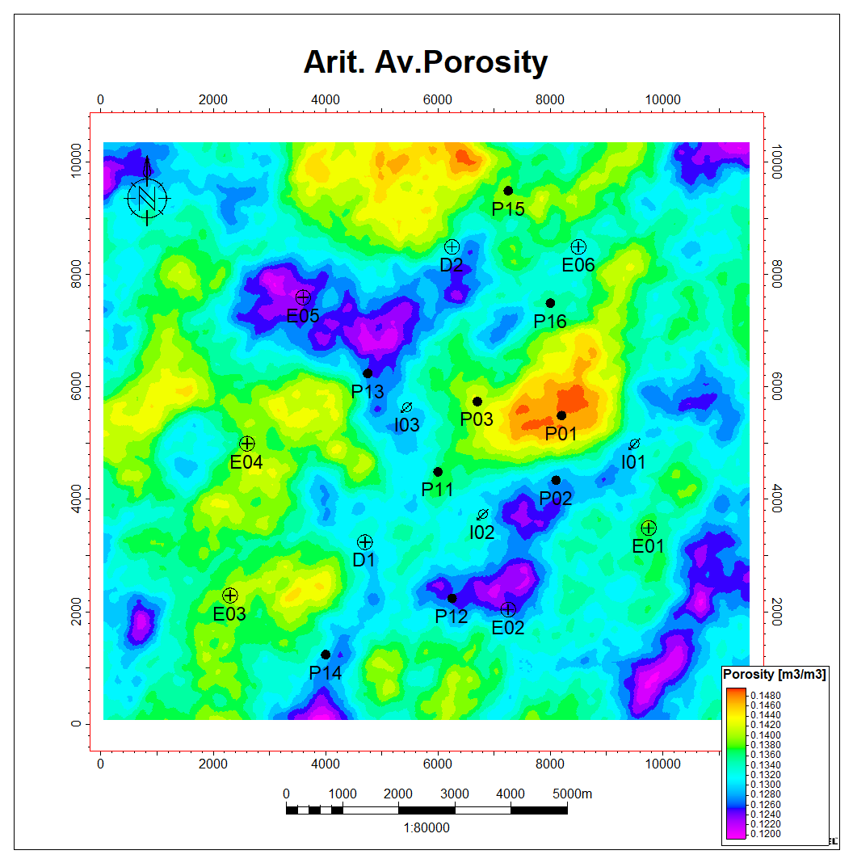
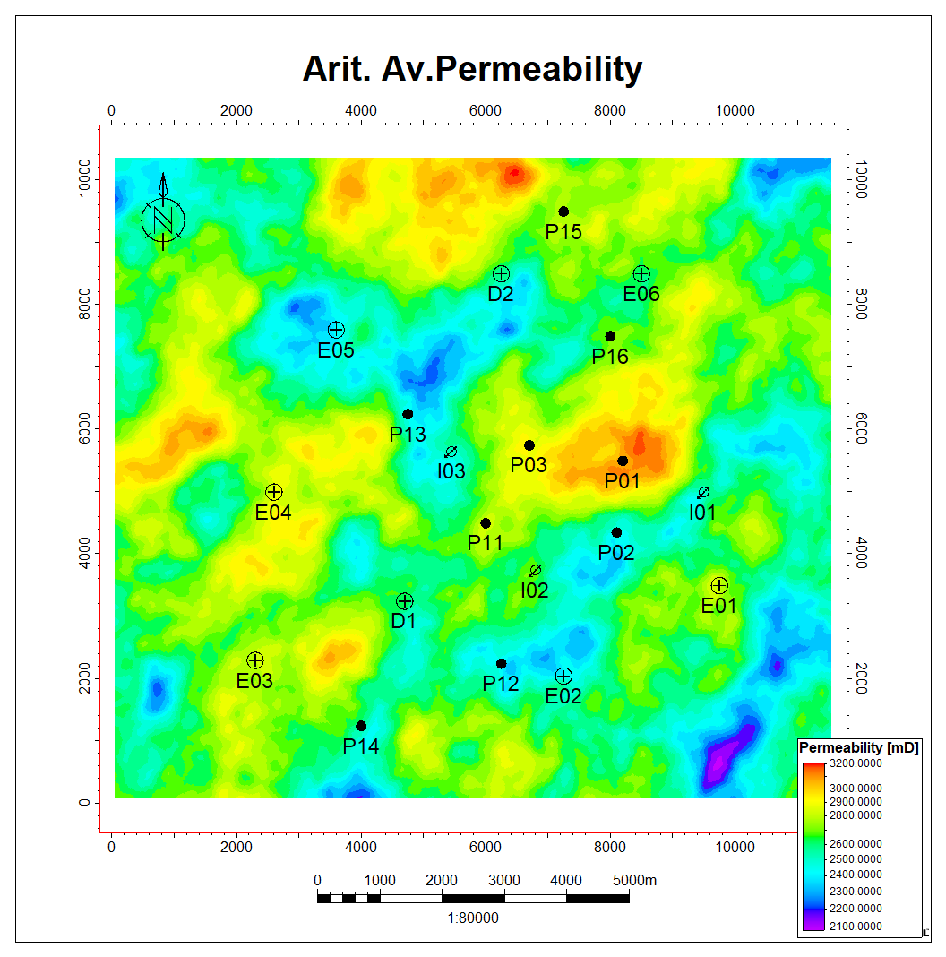
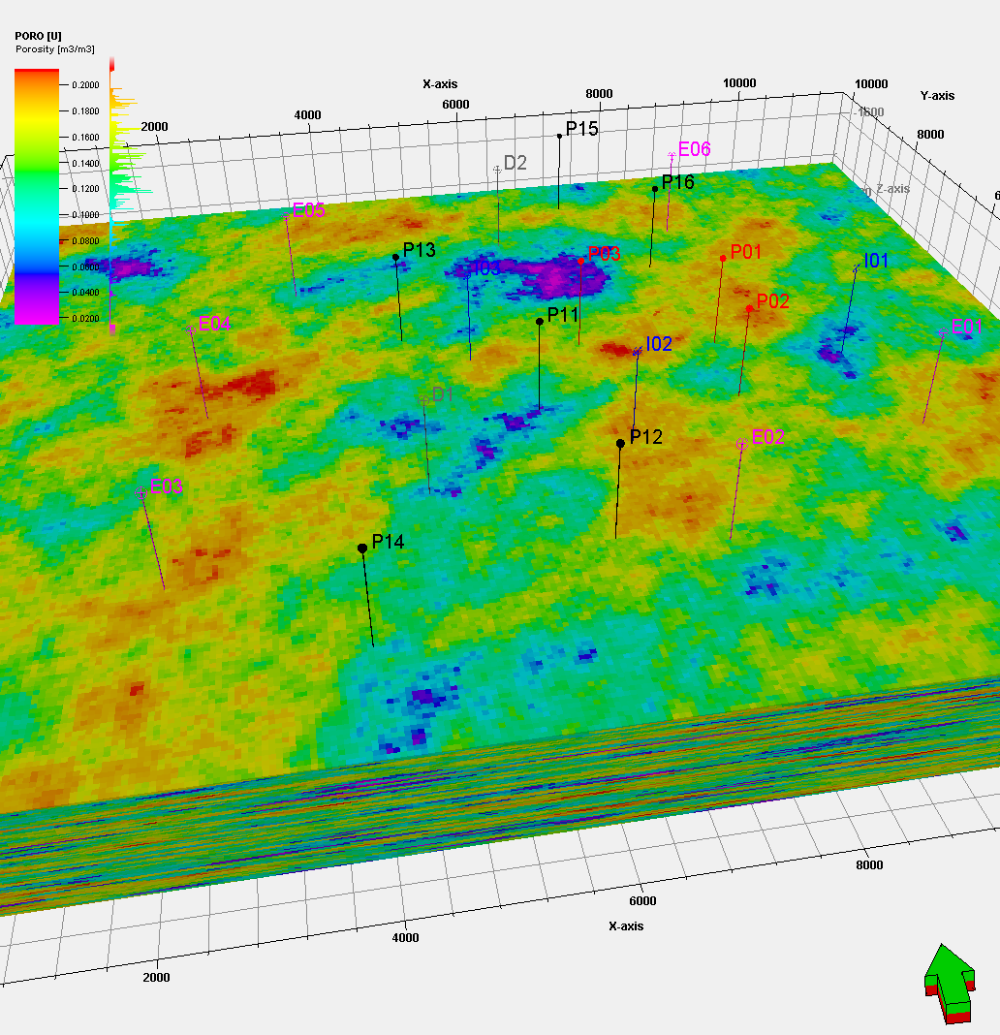
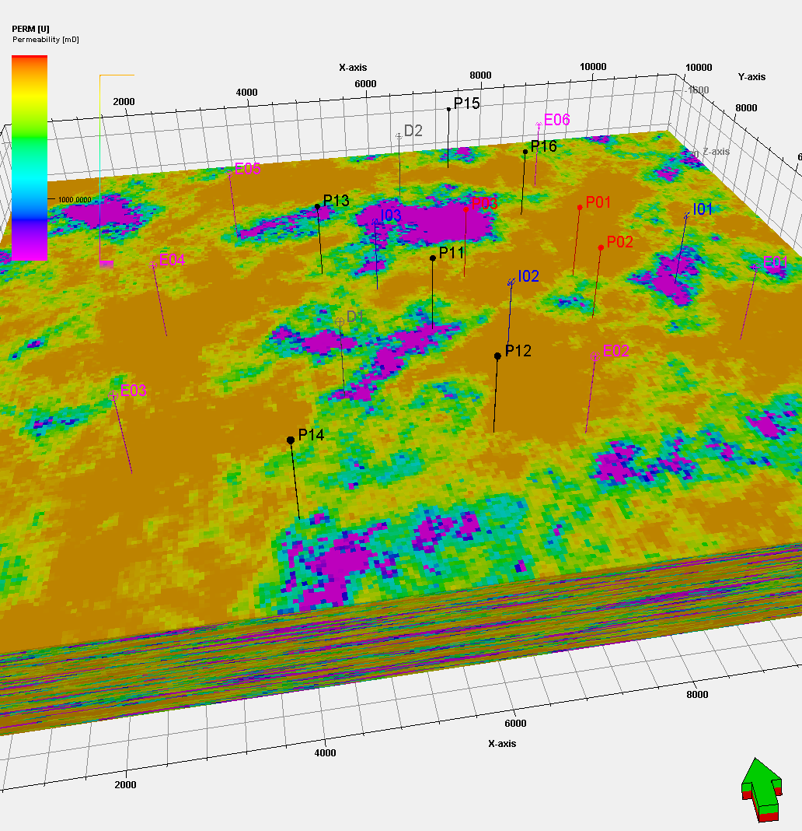
4. Methodology
Arithmetic Average maps of porosity and permeability properties
Methodology
Permeability log was estimated by using a logarithmic function that honors the well test permeability and average porosity of 4 wells (P03, I03, P02, I02).
3D grid was built using the same dimensions as DARTS model nx: 230 cells by ny: 206 cells, 50 metes in X&Y. nz: 380 layers, 4 meter in Z.
Gaussian Random Function algorithm was applied to distribute sonic, porosity and permeability. Variography analysis was done for each property.
Perform a Monte Carlo analysis to select a P50 case.
Create arithmetic average map and based on good poro-perm patterns, identify locations of potential wells to be simulated.
3D perspective view of porosity model
3D perspective view of permeability model

Slide 6
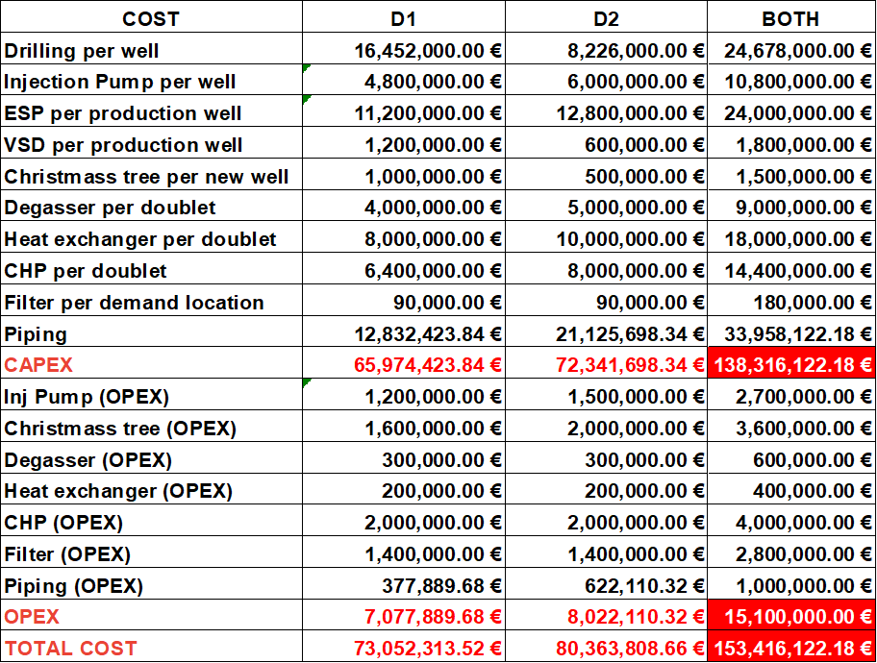
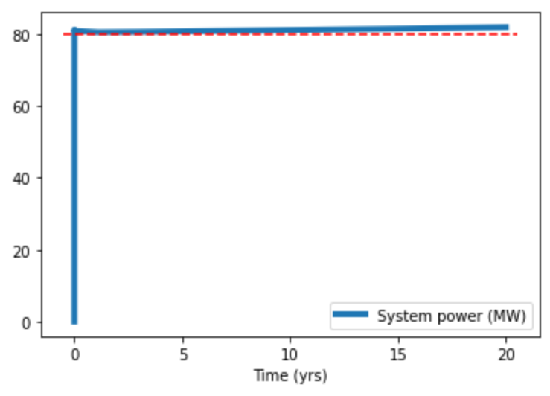
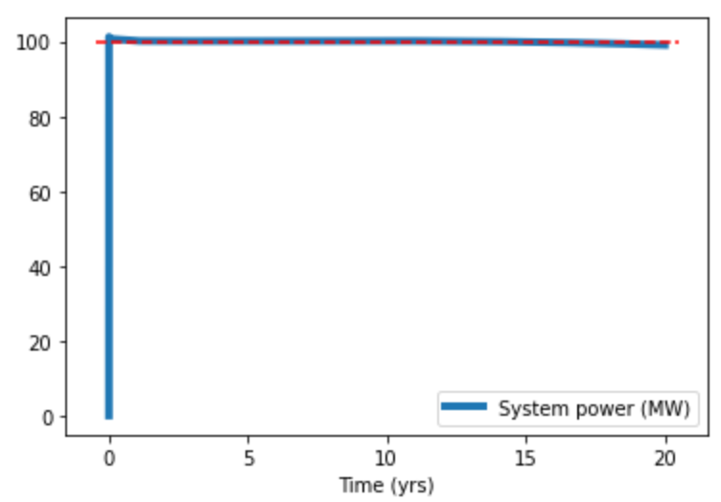
5. Results
Results
The length of surface piping is 56.6 km
The total cost of piping installation is €34M
The net volume of the produced and injected geothermal fluid equal to zero
Demand for 20 years: D1 - >80 MW, D2 - >100 MW
D1
D2

Slide 7
6. Conclusions
Conclusions
Well data was acquired based on the specific criteria with the aim to build a 3D reservoir model with porosity and permeability properties. They permitted as to identify the connectivity patterns for the location of 6 produced wells to achieve energy demand in D1 (>80MW) and D2 (>100MW)
Proposed development plan requires drilling of 6 additional production wells (4 for D1 and 2 for D2 demand)
LCOH for 20 years: D1 - 4913€/MWh, D2 - 4325€/MWh
CAPEX - €138.3M (including €34M for 56.6 km of piping). OPEX - €15.1M

